Slide 1
keynotes
CS 147
Interactive High-Fi Prototyping

Slide 2

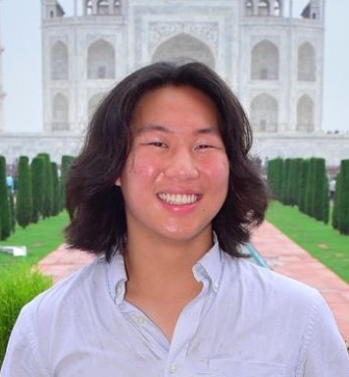


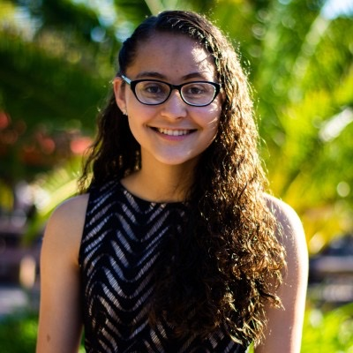
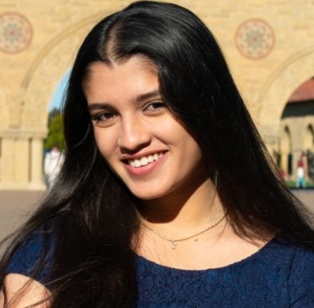
Our Ensemble!
Will Fang
Julia Hernandez
Emily Macias
Aditi Tuli
CS AI ‘25
French Horn!
SymSys HCI + Soc ‘24
Viola!
CS HCI ‘25
Guitar!
SymSys Neuroscience ‘25
Piano!

Slide 3
Roadmap
01
keynotes
02
HE Results
03
Revisions
04
Demo!
05
Next Steps
Notes:
A little roadmap for where we’re going - it’s a lot, so buckle up!

Slide 4
Roadmap
01
keynotes
02
HE Results
03
Revisions
04
Demo!
05
Next Steps
Notes:
A little roadmap for where we’re going - it’s a lot, so buckle up!

Slide 5
keynotes
where feedback strikes a chord

Slide 6

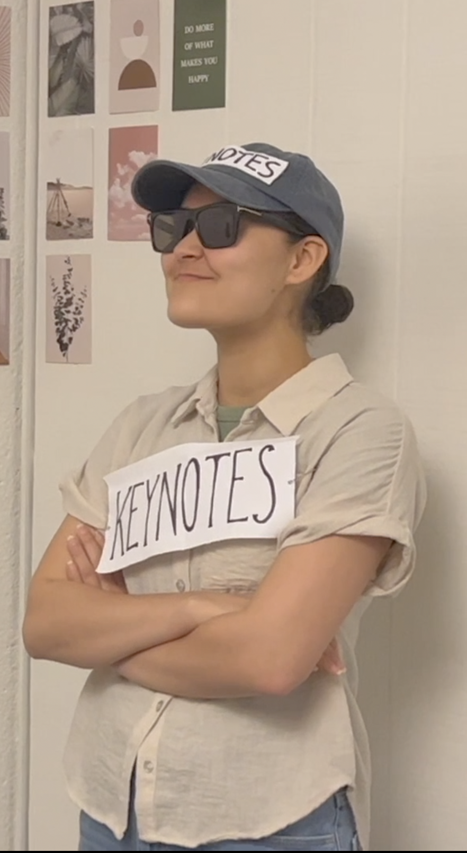
What is keynotes?
Creates a platform where musicians can connect and obtain crowdsourced and one-on-one feedback
Our Value Proposition:
pssst…watch our concept video!

Slide 7
The Problem
Problem:
Musicians struggle to find reliable sources of feedback, which impacts their confidence and self-perception

Slide 8

The Problem + Solution
Problem:
Musicians struggle to find reliable sources of feedback, which impacts their confidence and self-perception
Solution:
A platform where musicians can connect and obtain one-on-one and crowdsourced feedback

Slide 9
Roadmap
01
keynotes
02
HE Results
03
Revisions
04
Demo!
05
Next Steps
Notes:
A little roadmap for where we’re going - it’s a lot, so buckle up!

Slide 10
High-Level HE Summary
Our most common violations were…
H4: Consistency and Standards (18), H8: Minimalist Design (19)
  Visual design elements are inconsistent and distracting
    Colors, buttons, text
H1: Visibility of System Status (11)
  No indication of successful/unsuccessful actions
H6: Recognition not Recall (11)
  No reminders of key information about tracks/users necessary for multi-step task flows
H7 Flexibility and Efficiency of Use (11)
Notes:
Provided feedback on how intuitive our interface was to navigate but not on what features our target audience would actually want to use or would appreciate from our current design
Users were confused about the premise of a paper prototype which impacted their ease of use and therefore our results
Does not account for tasks getting progressively easier because users become more acquainted with the platform (versus because the tasks actually have better UI)
Timing is affected by our efficiency as computers

Slide 11
Major Violation Group 1
Consistency and Standards, Aesthetic Design, Visibility of System Status
Description
General aesthetics and color palette did not match the keynotes value proposition. Further, the use of color to highlight possible user actions was not as intentional as it could have been
Illustrative Example
H1 Visibility of System Status / Severity: 3
Task: Find a new musician and give feedback
Description: Can’t tell which tab I am on in the navigation panel.
Rationale: Users may get confused as to where they are in the app.
Fix: Update UI to switch tab color based on where you are

Slide 12
Major Violation Group 2
Visibility of System Status
Description
There was a lack of feedback to users when they successfully complete a task (leaving feedback, uploading a track or changing their settings)
Illustrative Example
H1: Visibility of System Status / Severity: 3
Description: There is no notification for whether the uploading process has completed or if the file is ready for upload.
Rationale: Users should be notified throughout the upload process and may be confused on whether they are ready to post track.
Fix: Create a progress upload bar for a visual representation of upload status.

Slide 13
Major Violation Group 3
Recognition Not Recall
Description
Generally, pages were missing reminders of key information about tracks/users necessary for multi-step task flows
Illustrative Example
H6: Recognition not Recall / Severity: 3
Description: Users do not have access to the track they are commenting on once they click on give feedback.
Rationale: Users have to actively recall the track or go back to the “Explore” page to relisten, which can be frustrating when giving feedback.
Fix: Provide the track at the top of the “give feedback” page to make the feedback giving process more efficient.

Slide 14
Major Violation Group 4
Flexibility and Efficiency of Use
Description
There was a lot of friction created when the user wanted to view the feedback they have received on a track
Illustrative Example
H7: Flexibility & Efficiency of Use / Severity: 3
Description: Users cannot organize feedback when searching for specific answers to questions.
Rationale: It is inefficient for a user that is working to fix a particular problem in their music when they are unable to search through a categorized list of feedback to find answers to their questions.
Fix: Add a notification section to view new notifications of feedback. Categorize feedback and let users see if their question has been answered.

Slide 15
Roadmap
01
keynotes
02
HE Results
03
Revisions
04
Demo!
05
Next Steps
Notes:
A little roadmap for where we’re going - it’s a lot, so buckle up!

Slide 16
Revisions tl;dr
…everything

Slide 17
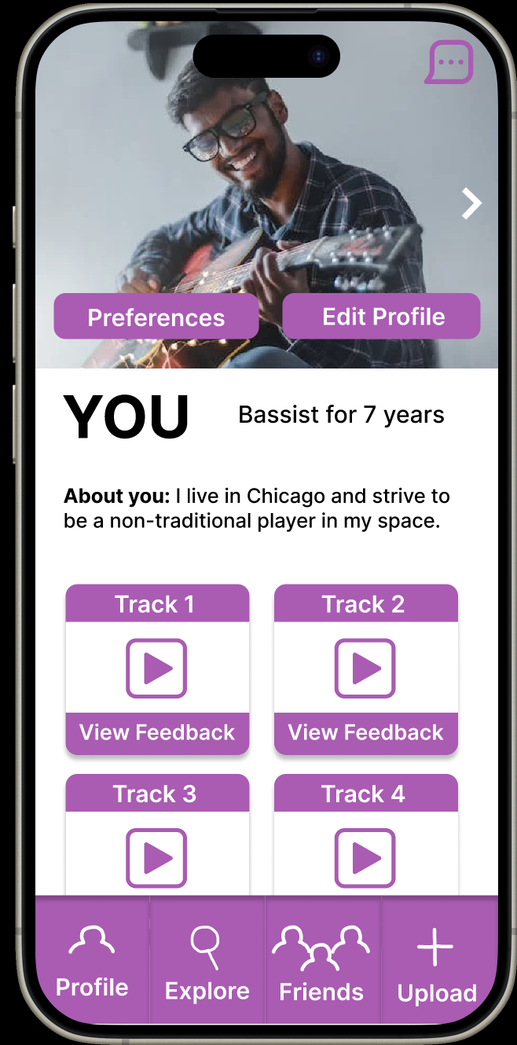
Major Violation Group 1: Before
Consistency and Standards and Aesthetic Design
Overuse of bright purple
Usability Goal Issues:
Robustness: users may erroneously mix up elements because of visual similarities
Efficiency: lack of consistency makes interacting less intuitive/requires more mental load
Text color, size, weight inconsistent without meaning

Slide 18
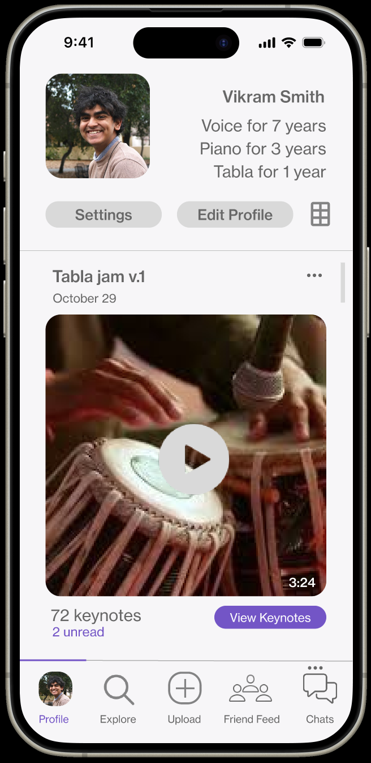
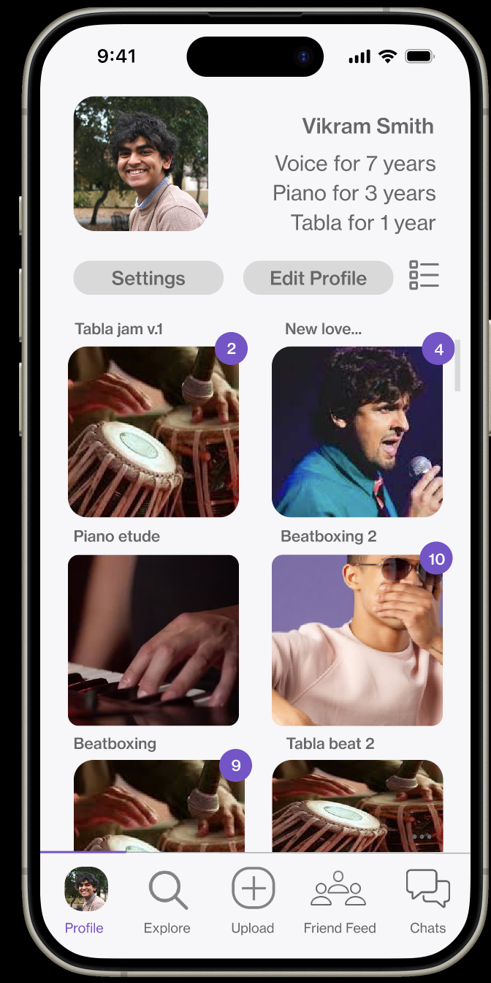
Major Violation Group 1: After
Purple used sparingly and to indicate most important elements on screen
Usability Goal Progress:
Robustness: Users can visually categorize different elements, reducing confusion-based errors
Efficiency: Users can quickly and intuitively group different elements together based on visuals
Buttons standardized, text indicates hierarchy of info

Slide 19
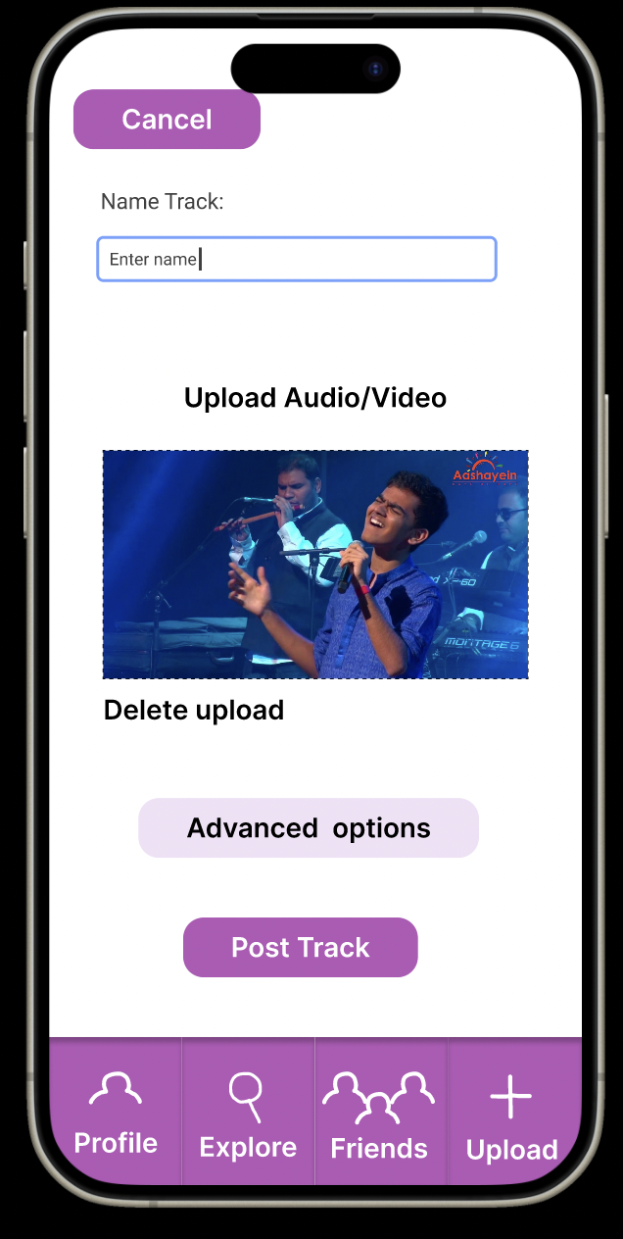
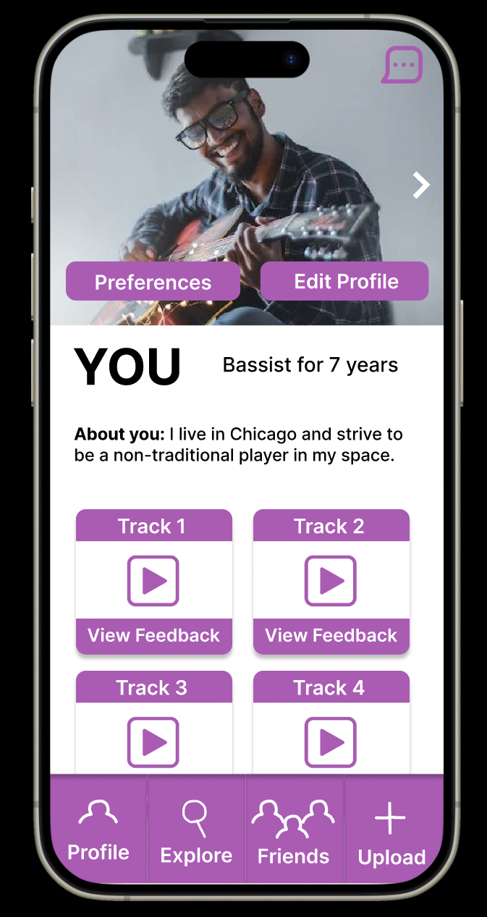
Major Violation Group 2: Before
Visibility of System Status
No feedback to the user confirming that their action of posting the track was successful
Usability Goal Issues:
Robustness: Users may try to upload the same post again
Efficiency: Users may waste time checking if the track was uploaded

Slide 20
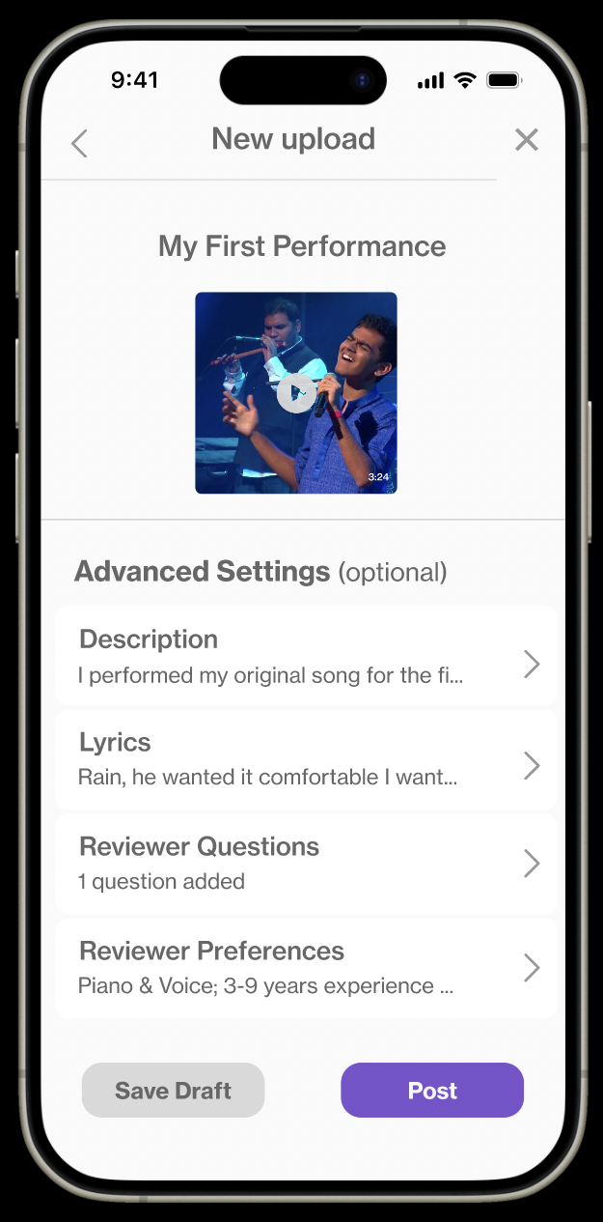
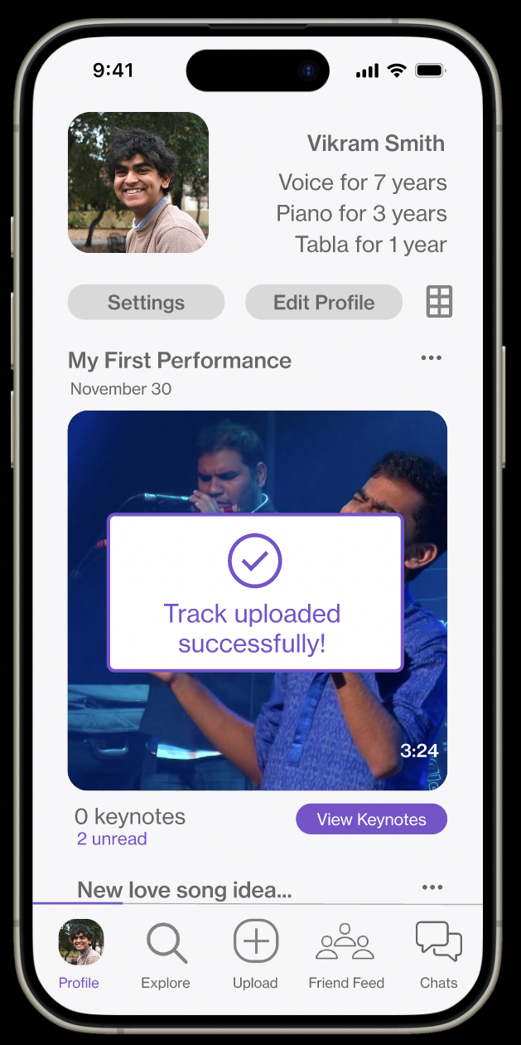
Major Violation Group 2: After
Users get a signal that they their action was successful, giving them peace of mind
Usability Goal Progress:
Robustness: Users will know the track was uploaded and are less likely to make the error of re-uploading it
Efficiency: Users will be able to move on to the next task without checking if the previous task was successful, saving time

Slide 21
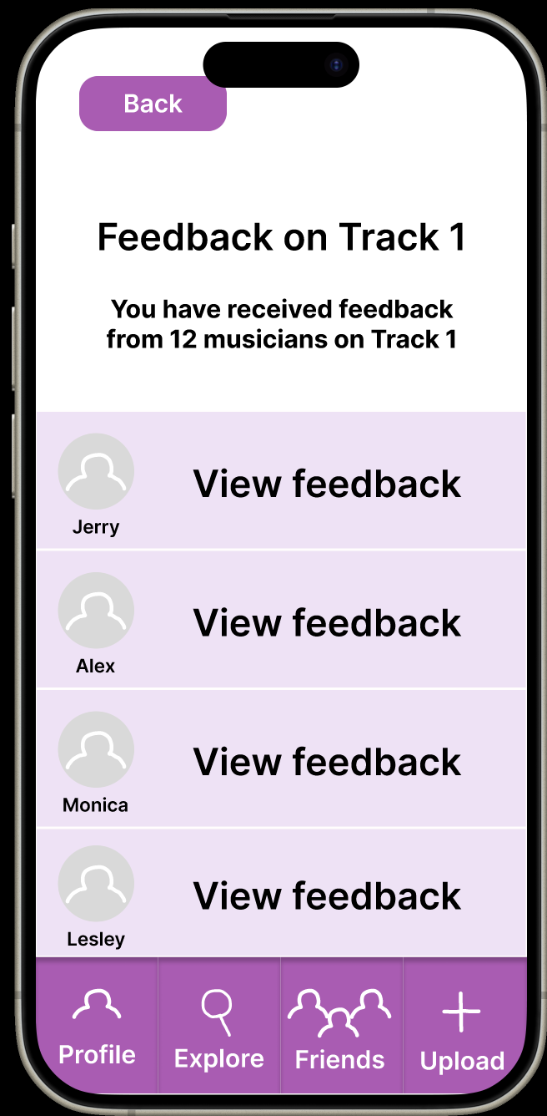
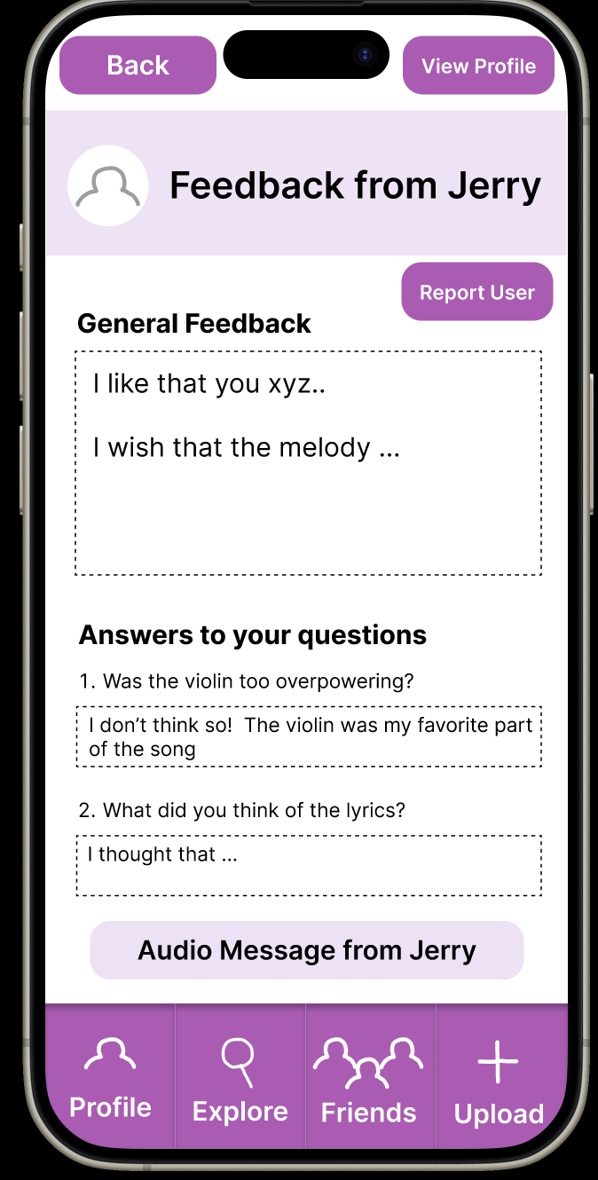
Major Violation Group 3: Before
Recognition Not Recall
No ability to play the track on either screen, no reminder of which track Jerry is reviewing
Usability Goal Issues:
Robustness: Users may forget which track’s feedback they’re looking at
Efficiency: Users may waste time going back to check which track they’re on

Slide 22
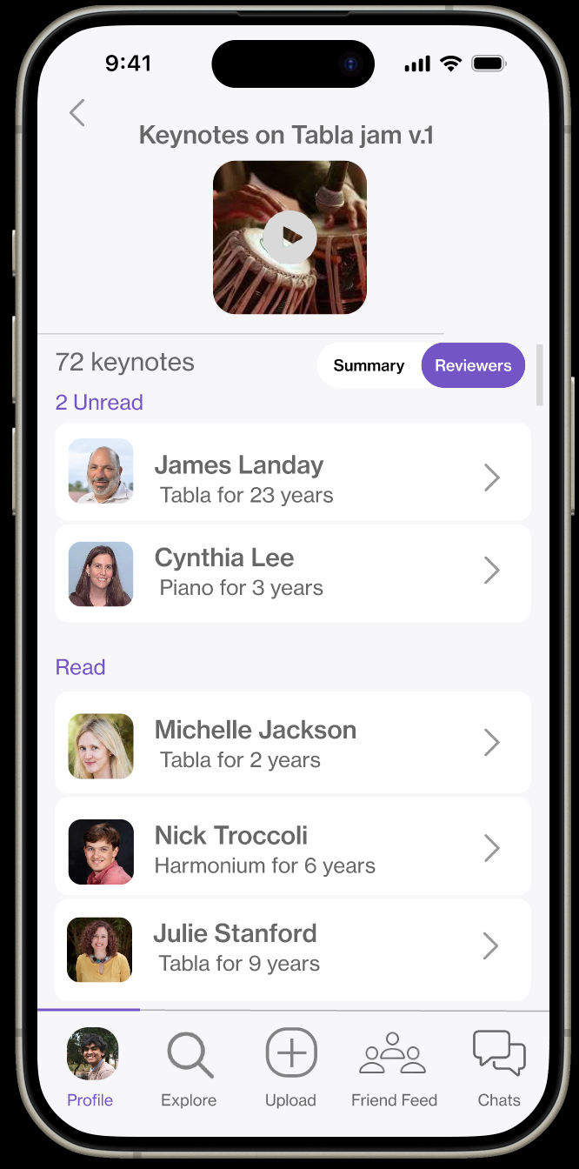
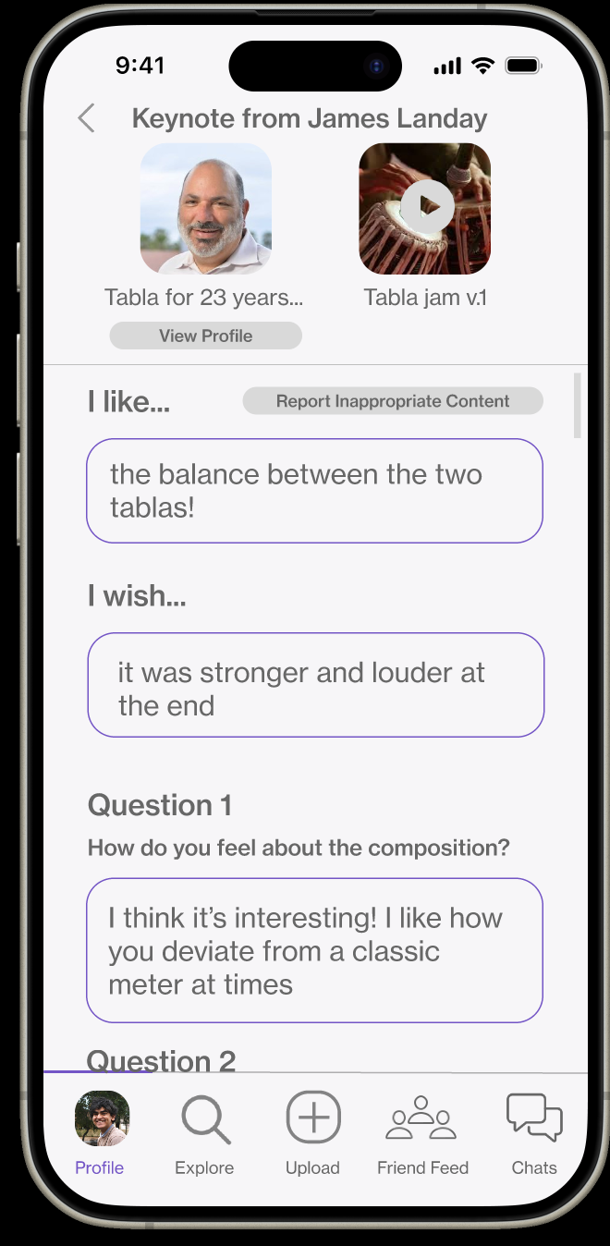
Major Violation Group 3: After
Users can play the track for which they are viewing feedback and see the reviewer who left feedback
Usability Goal Progress:
Robustness: Users will be reminded of key info, decreasing likelihood of a mistake based on misremembering a user/track
Efficiency: Users do not have to spend time trying to remember what they are doing on a certain page

Slide 23
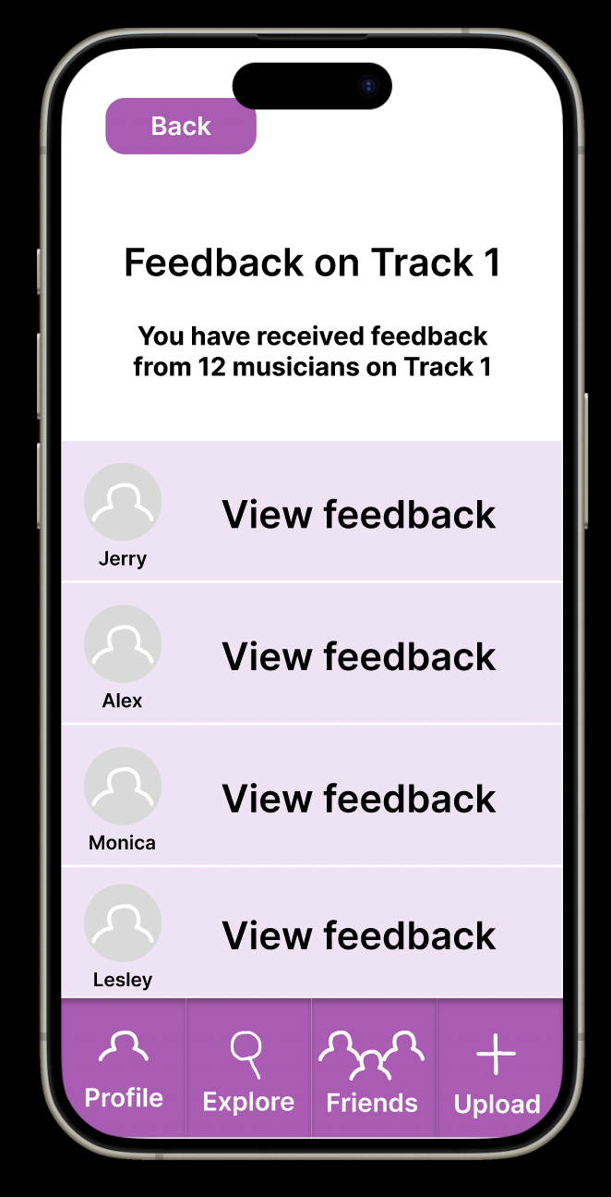
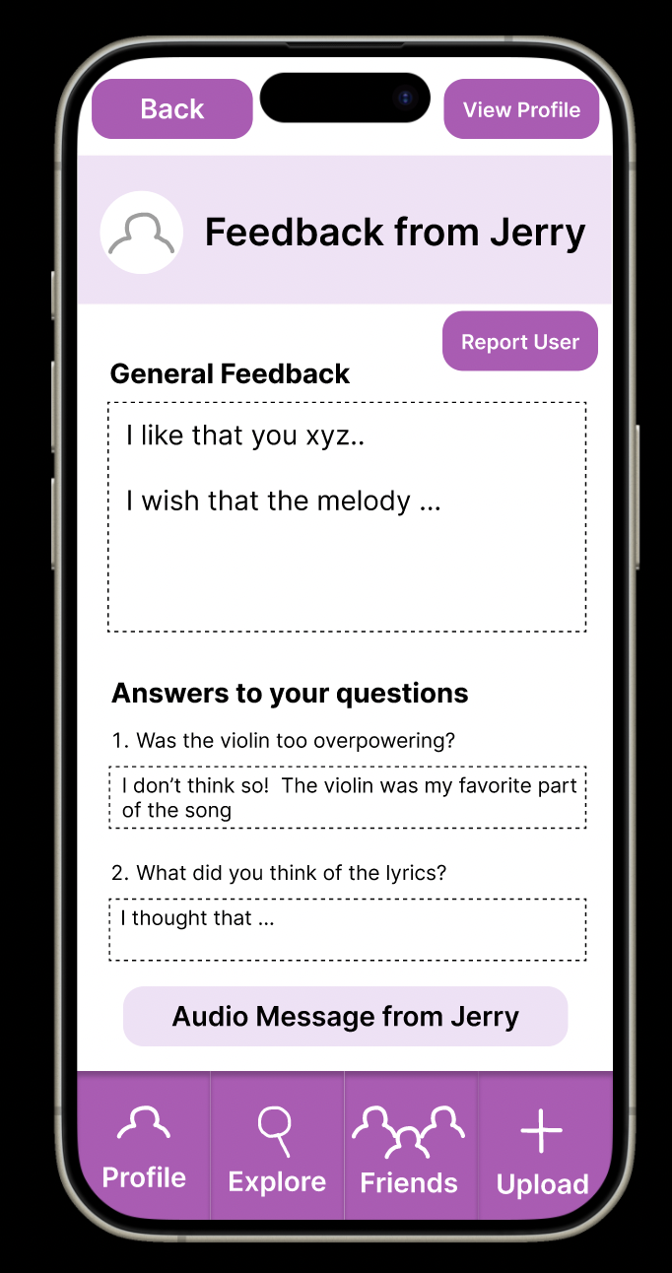
Major Violation Group 4: Before
Flexibility and Efficiency of Use
Vague message about number of feedback from musicians
No information about the user giving feedback to provide context
Usability Goal Issues:
Robustness: Users may click on the wrong person’s feedback when searching for a specific type of feedback
Efficiency: Users will waste time tapping into each user’s profile

Slide 24
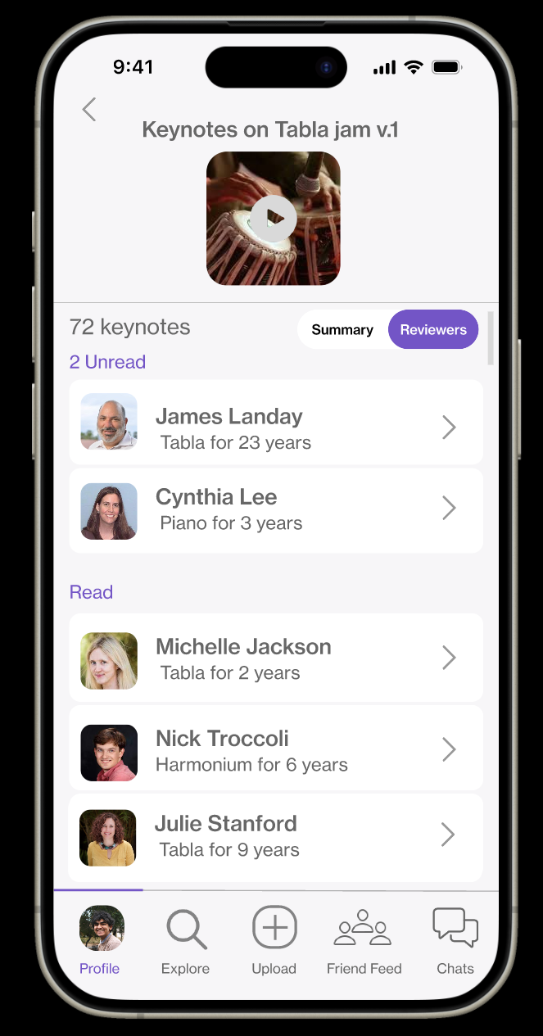
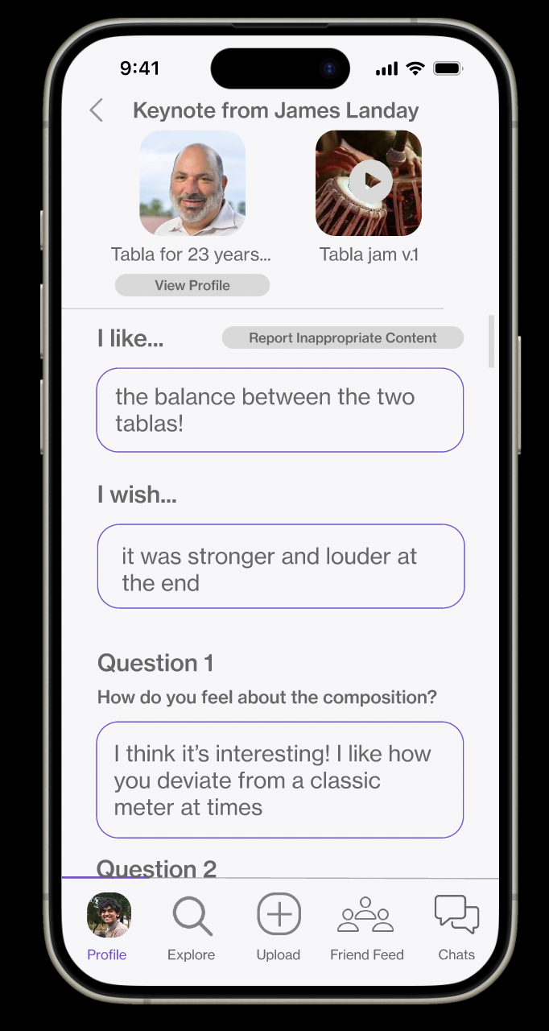
Major Violation Group 4: After
keynotes are filtered into read and unread, with a total number of keynotes listed above
Key information about the person giving feedback is listen on both screens
Usability Goal Progress:
Efficiency: Users will be able view the feedback in the context of who is giving the feedback on the same screen, saving time

Slide 25
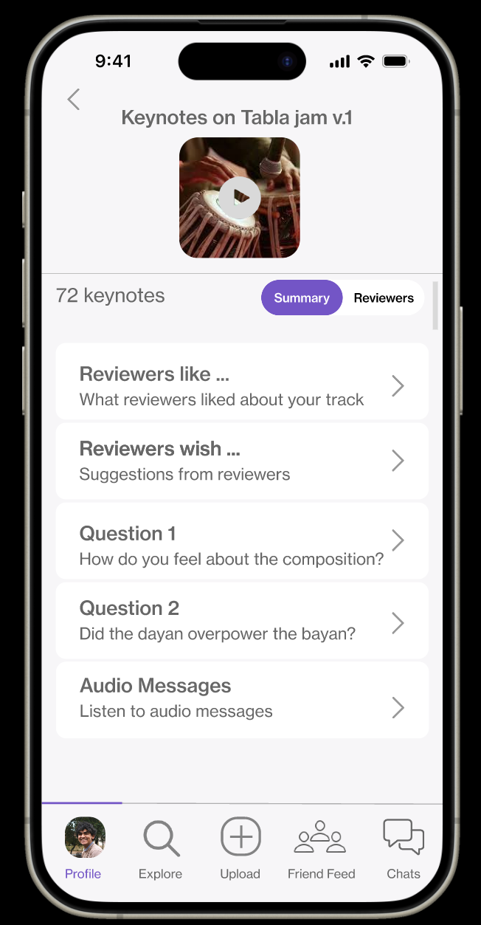
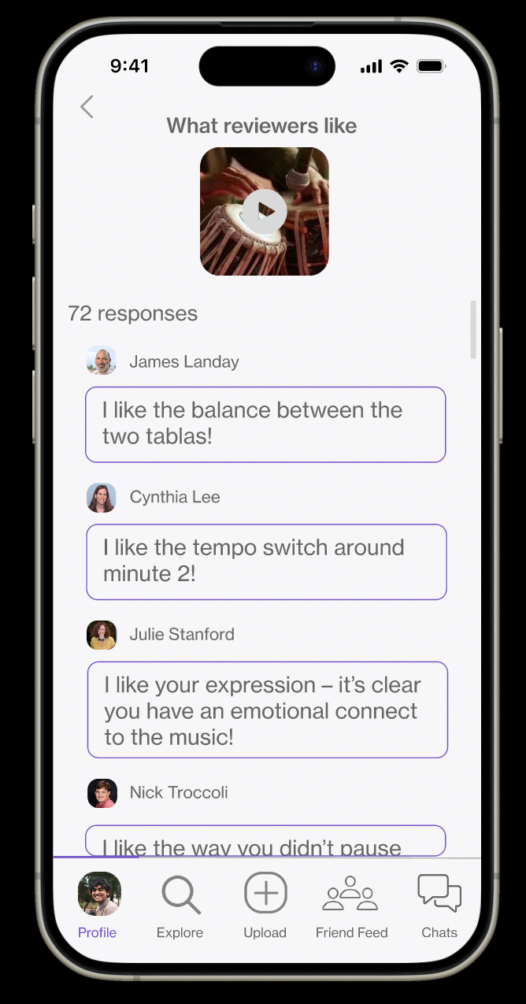
Major Violation Group 4: After
Users can also view their feedback in an aggregated form, separated into positive comments, negative comments, and answers to their questions
Usability Goal Progress:
Efficiency: Users can find answers to specific questions faster
Flexibility: Users have more control over their experience and can achieve the same task in multiple ways

Slide 26
New Figma

Slide 27
Roadmap
01
keynotes
02
HE Results
03
Revisions
04
Demo!
05
Next Steps
Notes:
A little roadmap for where we’re going - it’s a lot, so buckle up!

Slide 28



Programming Tools
React Native
Supabase
Expo Go

Slide 29
Implemented Features
Task 1:
Upload Post for Feedback
Upload a video

Slide 30

Implemented Features
Task 1:
Upload Post for Feedback
Upload a video
Add a title

Slide 31
Implemented Features
Task 1:
Upload Post for Feedback
Upload a video
Add a title
Advanced Options
(description, lyrics, reviewer questions, visibility)

Slide 32
Demo Video

Slide 33


Slide 34
Roadmap
01
keynotes
02
HE Results
03
Revisions
04
Demo!
05
Next Steps
Notes:
A little roadmap for where we’re going - it’s a lot, so buckle up!

Slide 35
Unimplemented Features
Task 1 Backend: In Progress
Task 2: View feedback on post
Task 3: View others’ posts and give feedback
Task 4: Change default preferences

Slide 36
Wizard of Oz + Hardcoded
Unimplemented Features
Saved data between screens + searching
Uploading audio
Posting
Wizard of Oz
Auto-generated lyrics
Hardcoded Features
Saved data between screens + searching
Uploading audio
Posting

Slide 37
Plans For Implementation: Task 1
Hardcoded Features
Saved data between screens + searching
Uploading audio
Posting
Implement saving data between screens
Uploading audio from phone
Post to Supabase
Smaller General Implementation Needs
Adding icons to tab navigator
Updating characters in description for character limit

Slide 38
Plans for Next Tasks
Simple Task 2:
View feedback on a track
Moderate Task:
Find a new musician and give feedback
Complex Task:
Filter who can give you feedback
Timeline: weekend task
Frontend + attempt backend component
Timeline: weekend task
Frontend + attempt backend component
Timeline: weekend task + Mon-Wed task
Implement with hardcoded recommendations

Slide 39
Thank you!
Questions? Comments?

